Slide 1
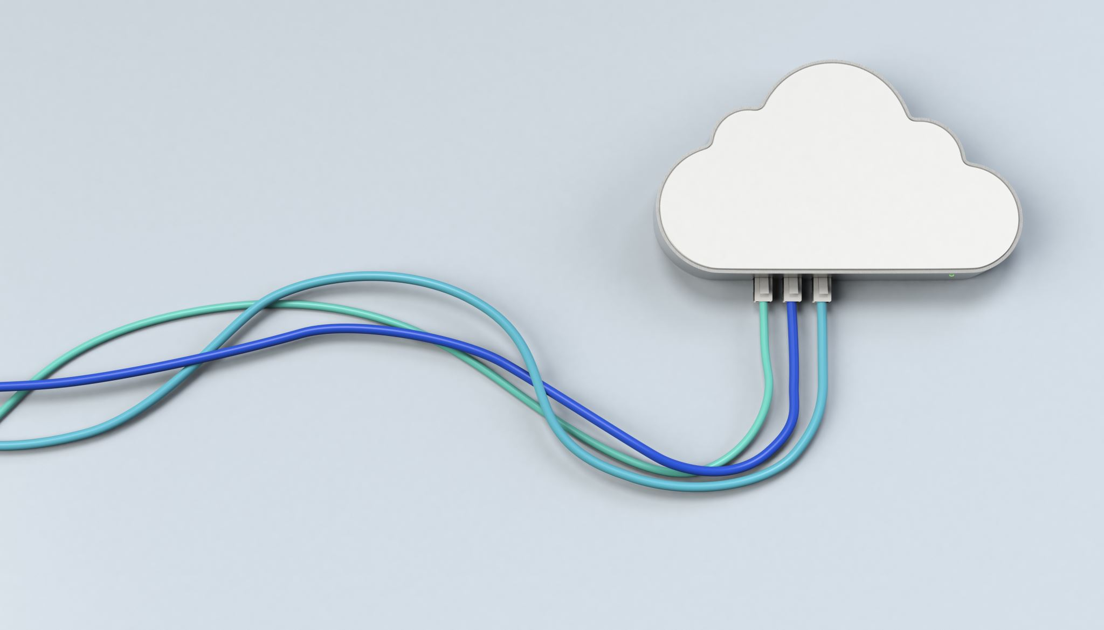
CHAPTER 1 Introduction
|Cloud Computing

Slide 2
Cloud Computing
Cloud Computing is the delivery of computing services over the internet
IBM
Cloud computing is a model of computing where scalable and elastic IT-related capabilities are provided as a service to external customers using Internet technologies.
Microsoft Azure
Cloud computing is the delivery of computing services—including servers, storage, databases, networking, software, and more—over the cloud (the Internet) to offer faster innovation, flexible resources, and economies of scale.
Amazon Web Services (AWS)
Cloud computing is the on-demand delivery of IT resources via the internet with pay-as-you-go pricing. Instead of buying and managing physical servers and other datacenter infrastructure, you simply pay for what you use when you use it.
Google Cloud
Cloud computing refers to the delivery of computing services over the internet—everything from servers, storage, databases, networking, software, analytics, and intelligence.

Slide 3
What is the Buzz About?
Current Trends and Hype
“Cloud computing is the next big thing in IT.”
Increased adoption of cloud services and solutions.
Impact on Business and Technology
Transformation of IT operations
Cost benefits and scalability

Slide 4
What is the Buzz About?
Ease of Access: Users can easily access computing resources whenever and wherever needed.
No Infrastructure Setup: Users do not need to worry about setting up infrastructure, purchasing equipment, or procuring licensed software.
Cost-Effective: Users can access any volume of computing facilities in exchange for a nominal payment.
Modern Integration: Cloud computing is made possible through the integration of advanced computing models, sophisticated web technologies, and modern network communication technologies (especially high-speed Internet).
Recent Popularity: Although cloud computing became a hot topic for major vendors (e.g., Amazon, Google, Microsoft) from mid-2008, the concept itself is quite old.
Perceptions:
Some view it as a new and radical innovation.
Others see it as an evolution of existing technologies and modernization.
Technology Evolution: Cloud computing has emerged from existing technology domains and its context, much like every new technology.

Slide 5
Limitations of Traditional Computing Approaches
High Costs: Hardware, maintenance, and upgrades
Scalability Issues: Difficulty in handling fluctuating demands
Complex Management: Need for extensive IT resources
Limited Accessibility: Physical constraints and location dependency

Slide 6
Is there Any Solution TO These Worries
Two Options for Setting Up IT Infrastructure:
In-House Setup: Deploy an internal team to manage IT infrastructure.
Outsourcing: Transfer responsibility to a third-party provider with expertise.
Concerns in Both Options:
Hardware Management: Maintenance and upgrades.
Software Installation: Ensuring compatibility and updates.
Application Implementation: Handling and integrating new applications.
Core Competency: These tasks may not align with the core competencies of users or organizations.

Slide 7
Is there Any Solution TO These Worries
IT Service Outsourcing:
Popularity: Adopted by enterprises to manage application development and implementation.
Limitations: Traditional outsourcing addresses some concerns but doesn’t fully resolve all issues.
Challenges of Traditional Outsourcing:
Varied Requirements: Different levels of computing facility subscribers have diverse needs.
Complex Tasks: IT service organizations may have specific requirements for application development, whereas other teams (e.g., maintenance) have different needs.
Layer-Specific Issues: Difficulties depend on the computing layers users are working with.
Potential Solution:
Cloud Computing: Can potentially remove worries related to hardware, software, and application management by providing scalable, on-demand resources and services, allowing users to focus on core tasks.

Slide 8
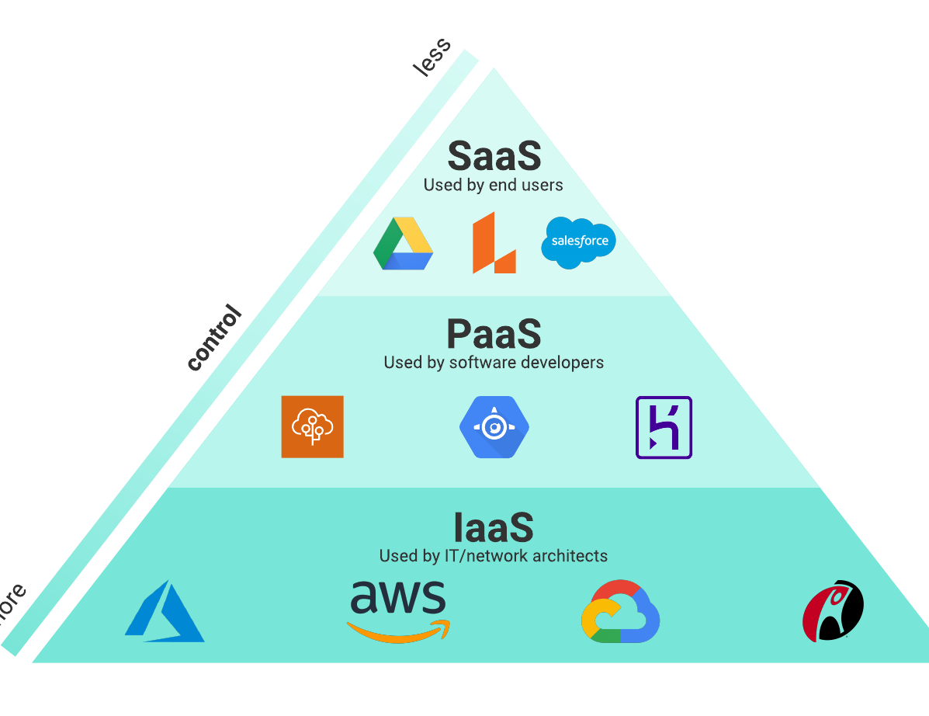
Three Layers of Computing
Infrastructure: “The foundation of cloud services.”
Hardware and virtual resources
Platform: “Tools and frameworks to build applications.”
Development tools and frameworks
Application: “End-user software delivered over the cloud.”
Software applications and services

Slide 9
THREE LAYERS IN TRADITIONAL COMPUTING
Hardware: Physical servers and storage
Operating System: Software managing hardware resources
Applications: User-facing software and tools

Slide 10
THE END OF TRADITIONAL COMPUTING
In traditional approach, computing subscribers were always over-burdened with many additional difficulties and costs
Shift to Cloud-Based Solutions:
Decline in demand for on-premises hardware
Increase in cloud adoption across industries
Transition Challenges: Migration strategies and integration

Slide 11

THE END OF TRADITIONAL COMPUTING
Limitations of Traditional Computing:
Longstanding Issues: Traditional computing faced limitations that had been evident for some time.
Futuristic Ideas: Various advanced computing techniques were proposed but could not be implemented due to technological constraints.
Technological Advancements:
Breakthroughs: Advances in computing and network communication technology enabled new possibilities.
Emergence of Cloud Computing: During the latter half of the last decade, a new computing model emerged.

Slide 12
THE END OF TRADITIONAL COMPUTING
Cloud Computing Model:
Philosophy: The model proposes delivering all computing facilities as services.
Three Main Layers:
Infrastructure: Hardware resources.
Platform: Development tools and frameworks.
Application: Software applications.
Delivery Model: These layers are provided as ready-made services, managed and maintained by the service providers.
Benefits:
Convenience: Consumers are relieved from the burden of arranging and managing their own computing resources.
On-Demand Services: Resources are available as needed, reducing the need for extensive in-house management.

Slide 13

Story of a Similar Scenario: A Century Ago
Early 1900s Electricity Generation:
In-House Production: Firms, especially manufacturers, generated their own electricity.
Burden: Required maintaining large infrastructure and a dedicated team.
Emergence of Power Grids:
Shift to External Supply: Firms began sourcing electricity from external providers.
Advantages:
No more managing coal deliveries.
Reduced need for specialized staff.
Concerns:
Reliability of power grids.
Security of supply lines.
Risk of vendor shutdowns.
Resolution:
Cost Efficiency: External suppliers offered lower costs compared to in-house generation.
Reliability: Over time, external power grids proved to be secure, reliable, and cheaper.
Outcome: By 1930, using external power grids became the norm, showing significant advantages over in-house generation.

Slide 14

Story of a Similar Scenario: A Century Ago
Moral of the Story:
Comparing to Cloud Computing:
Outsourcing IT Services: Similar to outsourcing electricity, cloud computing allows users to outsource IT services.
Benefits:
Users can access computing resources without managing their own infrastructure.
Only need to focus on usage and billing.
Modern Analogy: Just as external power grids became preferable; cloud computing services are likely to be more advantageous compared to maintaining internal IT setups.
Recommendation:
Adopt Cloud Computing: Continuing with internal IT infrastructure might be less efficient and more costly compared to leveraging cloud computing services, much like sticking to in-house electricity generation proved to be in the past.
This comparison highlights the evolving nature of technology and the benefits of adopting newer, more efficient models of service delivery.

Slide 15
Story of a Similar Scenario: A Century Ago
Historical Context:
Comparison with the industrial revolution
Transformation from manual labor to mechanized processes
Lessons Learned: Adaptation and innovation

Slide 16
People are Already Using Cloud Computing
Current Usage Trends:
Widespread use of cloud services in various sectors
Examples of cloud applications in everyday life
Case Studies: Organizations leveraging cloud computing for efficiency

Slide 17
Influences behind Cloud Service Adoption
Key Drivers:
Cost savings and financial benefits
Increased agility and flexibility
Technological advancements and innovation
Market Trends: Growth statistics and adoption rates
The idea of Cloud Computing is access anytime, anywhere, with any device

Slide 18
Influences behind Cloud Service Adoption Technological Influences:
Universal Network Connectivity: Connection around the globe
High Performance Computing: HPC affordable for everyone
Commoditization: Turns products into commodities that can be marketed.

Slide 19
Influences behind Cloud Service Adoption OPERATIONAL & BUSINESS Influences:
Low-Cost Solution
Outsourcing
Speed or Responsiveness
Automation
Small Initial Investment
Less Maintenance Cost
Mobility
Flexibility

Slide 20

Summary and Key Takeaways
Recap of Key Points:
Evolution from traditional to cloud computing
Benefits and drivers of cloud adoption
Future Outlook: Trends and expected developments in cloud computing

